Slide 1
WINNING MAJOR GIFTS
A one day course for those who:
are new to this area of fundraising
want to review their current approach
Trainer: Tricia Monro, MInstF

Slide 2

www.field-works.co.uk

Slide 3



For your comfort

Slide 4


Slide 5
Winning Major Gifts
We will cover
Defining a major donor
The current landscape of major gift fundraising
The key steps of a major gift fundraising
Your case for support
Major donor motivations
Setting financial and non financial targets
Resources needed for winning major gifts

Slide 6
By the end of the course you will be able to:
apply 3 criteria for identifying and assessing potential major donors
plan the next steps to develop or refine your major gift fundraising
identify the key people and resources needed

Slide 7
What’s a major donor ?
Significant impact
Mutual benefit
Money, time, influence

Slide 8
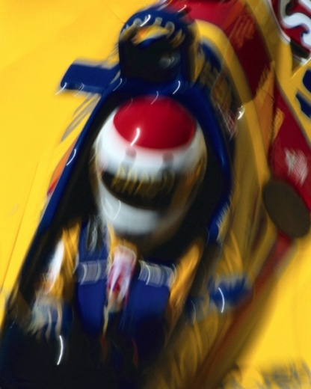
The new philanthropists
Bring money and skills
Invest in making an impact
Want greater involvement

Slide 9
Stephen Dawson
Venture Capitalist
“The biggest motivation for me was
to maximise impact, because I was
giving up my time as well as my
money.”

Slide 10
Sir Alec Reid philanthropist
“Good major donor fundraisers are
intelligently close to you. They’re
looking for a long-term relationship and they should treat you as a best friend. You wouldn’t strike an old friend off if you hadn’t seen them for a year, so why do it to a donor?”

Slide 11

Never forget
“People give to organisations that keep in touch.” (Ken Burnett)
“The core principle is that the more you get to know a donor, the more money you will raise”. (Val Morton)

Slide 12

The landscape for Major Gifts
Coutts Million Pound Report 2016
Year 2015
Total £1million+ gifts > £1.83bn
Number of £1m+ gifts > 355
Number of donors > 166
Total no of recipients > 267
24% (£431m) from individuals

Slide 13
Location of £1m donors by value
71% London
3%South East
0.5%South West
0.07%North East
2%North West
1%East Midlands
2%Scotland
21%Overseas
12%Unknown

Slide 14
Which causes benefit?
Higher education
Foundations
Overseas
Arts, culture, humanities
Health
Public & societal benefit
Environment and animals
Religious

Slide 15
Rise of the intermediaries
www.instituteforphilanthropy.org
www.philanthrophy-impact.org
www.thinknpc.org
www.communityfoundations.org.uk
www.youngphilanthropy.org.uk
www.thefundingnetwork.org.uk
www.impetus-pef.org.uk

Slide 16

True False
All fundraising organisations can
develop major donor fundraising

Slide 17
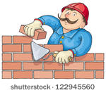
Are the foundations in place?
A flourishing and healthy
organisational structure
A strong case for support
The evidence and commitment to
developing major gift fundraising

Slide 18

The 8 steps to secure & keep your major givers
Identify
Research
Plan
Engage
5. Ask
6. Close
7. Thank
8. Steward

Slide 19
Common barriers to successful major gift fundraising
inadequate research
poor cultivation
deficient asks
bad stewardship

Slide 20
Step 1 : Identify them

Slide 21
Step 2: Research
Capacity to give
= resources & how much
Connections
= networks & access to them
Affinity / Propensity
= motivations & interests

Slide 22
To set your gift target
Identify the funding need and timescale
Analyse number of donors, their giving levels and history
Compare with history and achievements of other organisations
Seek the opinions and advice of your prospects’ peers
Build up a ‘picture’ of a likely ‘major donor’ to your charity

Slide 23
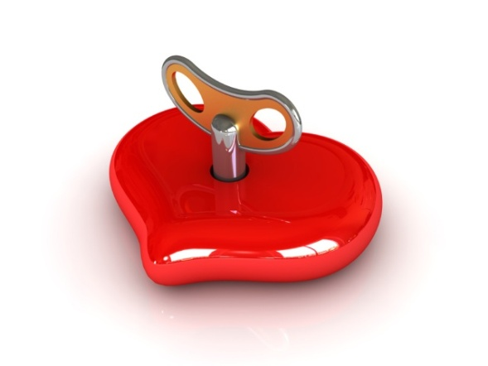
Understanding Motivations
What are the key ones
that will drive action?
Are they internal or
external?

Slide 24
4 key motivations
Philanthropy
Affinity
Social Recognition
Mutual Benefit

Slide 25
4 underlying motivators
Belief in your mission
Respect for your reputation and integrity
Confidence in your careful and wise spend of their money
Conviction in the effectiveness of your work

Slide 26
Thought for the day
“It is terrifying to think how much research is needed to determine the truth of even the most unimportant fact .” (Stendhal)

Slide 27
Step 3 : Plan
When will you ask?
What will you do to get them there?
Who will be involved? (in each activity)
How will you look after them / their gift?

Slide 28
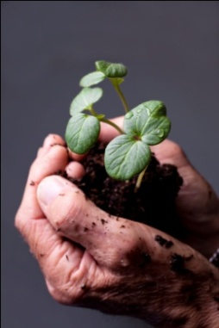
Step 4: Engage
[Cultivate]
The aim of cultivation is to deepen the relationship and understanding an individual has of your organisation, it’s vision, mission and aims and objectives.
It involves a programme of personal interaction between your organisation and your prospect with the purpose of building their interest, understanding and eventually significant support for your work.
Source : Institute of Fundraising

Slide 29
In other words…..
It involves responding to:
their motivations
what they like and
what they like about your organisation

Slide 30
Action prompts
Invite
Ask ?
Surprise
Thank
Give
Share

Slide 31
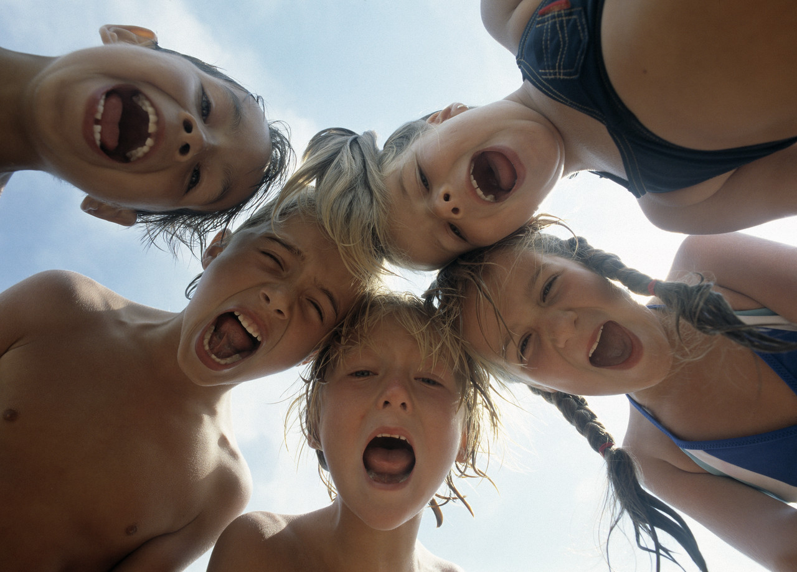
Making your Case for Support

Slide 32
Framing your Case for Support
IMPACT PRESENT FUTURE
Positive Opportunity Vision
Negative Crisis Risk

Slide 33
Keep stories at the heart

Slide 34
The Pinpoint Appeal
Targeting cancer with new technology
Opportunity
If you can help us raise the remaining funds for the CT scanner in the next 6 months, cancer sufferers will be able to have their treatment locally by Spring 2014.
Alison knows only too well what a difference that will make.

Slide 35

Step 5: Ask
The aim of solicitation is to provide an opportunity for the prospective donor to fulfil their philanthropic interest.”
Source: Institute of Fundraising

Slide 36

Asking
Asking is a two-way conversation
Know what outcome you want
No rarely means never

Slide 37
The WIN formula
Be clear what you ideally Want
Decide what you Intend to get
Be confident about what you Need

Slide 38
Step 6: Close
When and how gift to be processed
Bank details!!
Gift Aid info & advice
Receipt the gift

Slide 39
Step 7 Thanking
thank your donors so that they understand the impact they’ve made on your organisation
thank your donors so they want to give again and again and again

Slide 40
Step 8: Stewardship
Stewardship is the process whereby your organisation cares for and protects its philanthropic support in a way that responds to the donor’s expectations and wishes.
Source: Major Donor Fundraising Margaret M Holman Lucy Sargent

Slide 41
Good stewardship means that the donor:
Receives appropriate recognition of their gift
Understands how their gift will be used
Is able to build trust in your organisation and knows their money will be spent wisely
Has the opportunity to develop their level of involvement in your work
Understands and shares the vision of your organisation

Slide 42

In other words…
It’s about looking after the giver and their gift

Slide 43
Stewardship policies ensure gifts are:
Recorded
Processed
Acknowledged
Recognised in your organisation

Slide 44
Recognition = ?
showing you understand their motivations
providing the personal touch
acknowledging their value

Slide 45
Your next steps?

Slide 46


Good Luck and….
Be visionary…
Be bold !

Slide 47
www.field-works.co.uk

